Slide 1
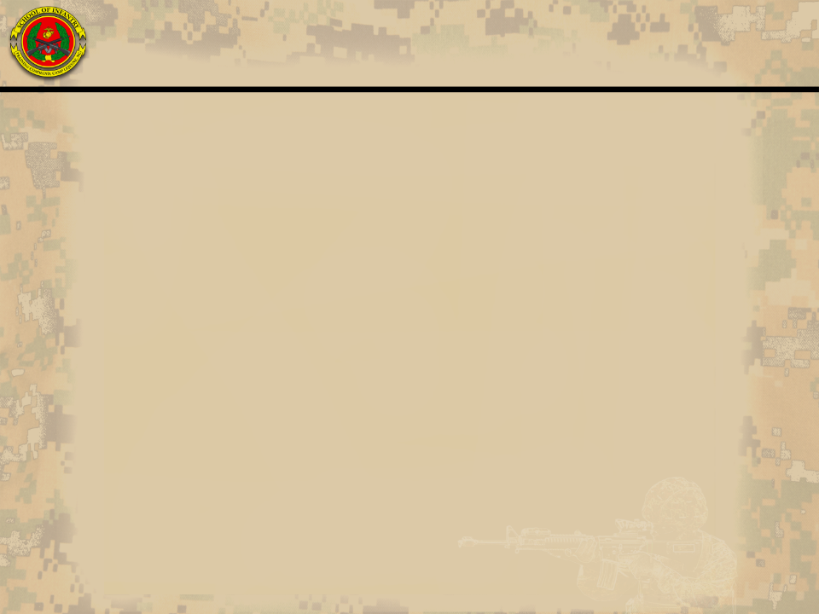



SOI-East Brief to Graduating Marines at MCRD Parris Island
“Only in the Marine Corps can you take an artillery man, or tanker, or a cook and tell him that he is an infantryman, and he’ll know what to do.”
-General C. E. Mundy
30th Commandant of the Marine Corps
“Every Marine is, first and foremost, a Rifleman.”
-General A. M. Gray
29th Commandant of the Marine Corps

Slide 2
Agenda
Mission
Training
Reporting
Important Information
Expectations on Leave
Questions

Slide 3
Mission: School of Infantry-East
“The School of Infantry-East conducts standards-based common combat skills, entry-level infantry skills, and advanced infantry skills progression training through Combat Instructors in order to provide professionally trained Marines prepared for service throughout the Marine Corps.”

Slide 4
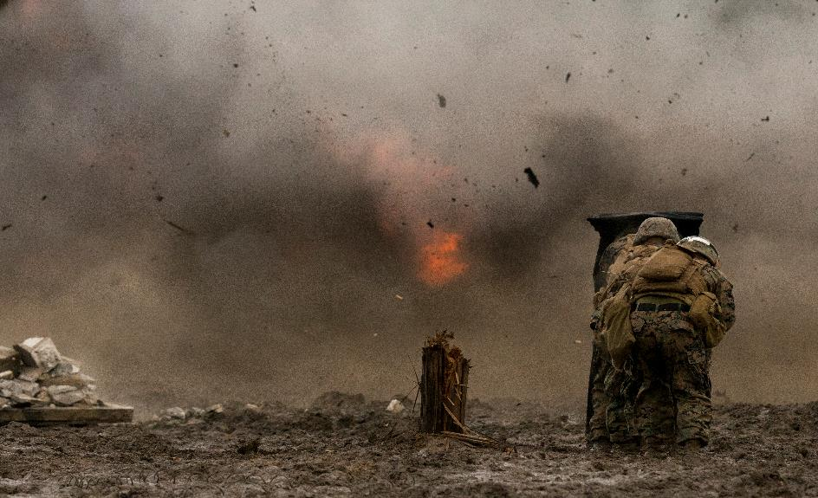
Training
Photo

Slide 5

Mission: Marine Combat Training Battalion (MCTBn)
“Through the use of professional Combat Instructors, MCTBn trains, coaches, and evaluates basically-trained Marine riflemen in order to meet Fleet Marine Force, supporting establishment, and reserve force combat requirements to fight and win in both current and future operating environments.”

Slide 6
MCTBn
21 training days, 9 administrative days
Every Marine a Rifleman Outcomes:
  Embodies the Marine Corps warfighting ethos.
  Has an expeditionary mindset with a bias for action.
  An adaptive critical thinker who is mentally, morally, and physical resilient.
  Lethal with their weapon and proficient in basic field skills.
  Possesses a foundational understanding of leadership, the basic tenants of maneuver warfare, and the future operating environment.
Training is continuous through weekends.
After graduation, report to follow-on MOS school.
Families will not be granted access to base for graduation.
Leave is not normally granted at or in between MCT Bn and follow-on MOS schools.

Slide 7
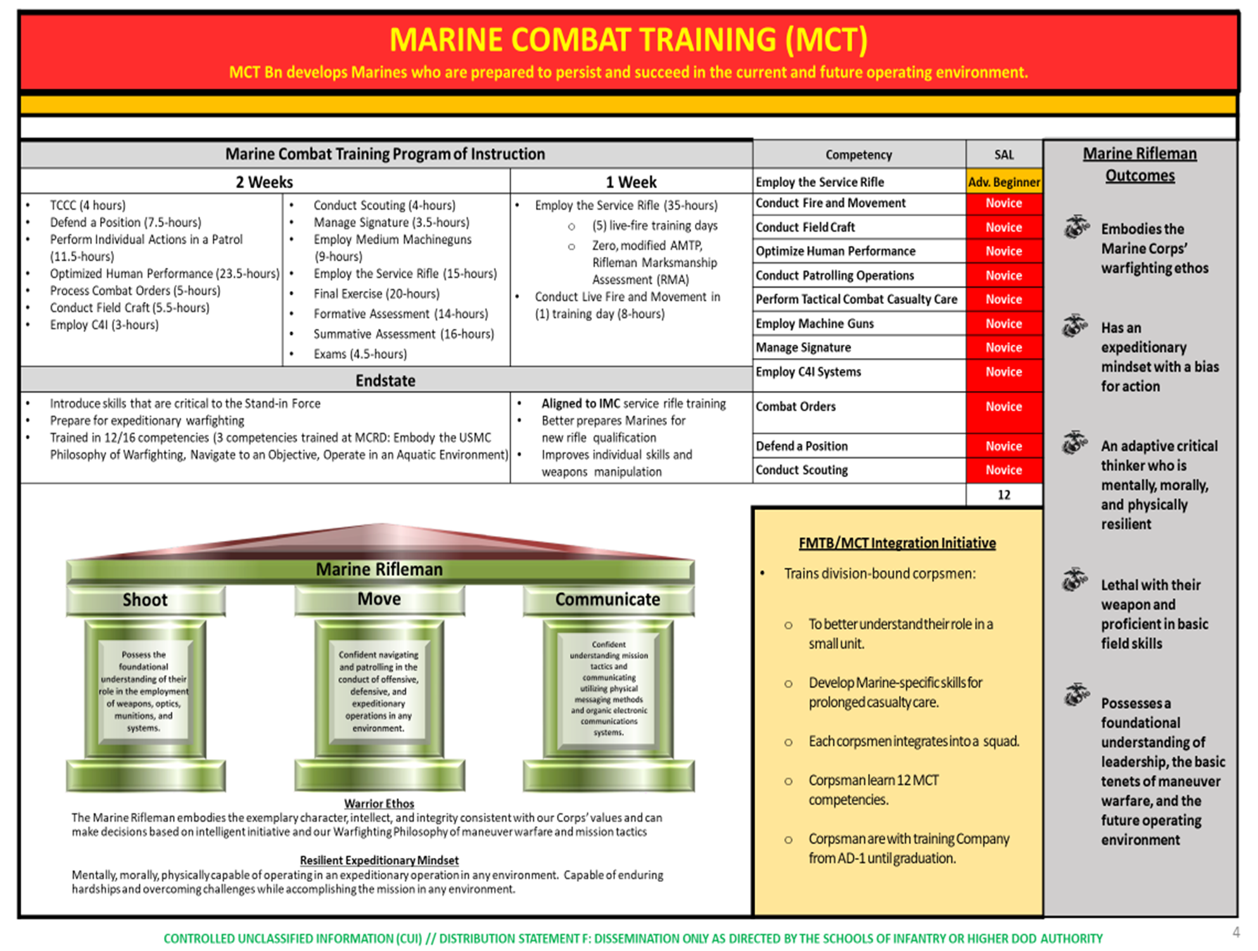
MCTBn

Slide 8
Mission: Infantry Training Battalion (ITBn)
“Train, mentor and evaluate Marines in field craft and MOS specific entry-level tasks under the leadership of Combat Instructors in order to provide basically qualified infantry Marines prepared for service in the operating forces.”

Slide 9
ITBn
Infantry Marine Course
69 training days over 14 weeks
  Course Entry Standards: Strength & Power Assessment, 2nd Class PFT&CFT (run prior to picking up with IMC Class), contract individual assignment standards for pull-ups (6), 3-mile run (24:51), 800m run (3:26), ammo can lifts (60), MANUF course (3:12), and Water Survival Basic.
  Course Exit Standards: Meet prescribed skill acquisition levels, pass warfighting exercise, 1st class PFT & CFT, Water Survival Intermediate, and Combat Endurance Assessment (O-Course in 4 min, 10km Ruck in 105 min, MUF in 4 min).
  Marines are trained and evaluated on 20 competencies and must achieve the desired skill acquisition level. Most skillsets require either novice or advanced beginner level.
Every graduate receives 0311 MOS

Slide 10
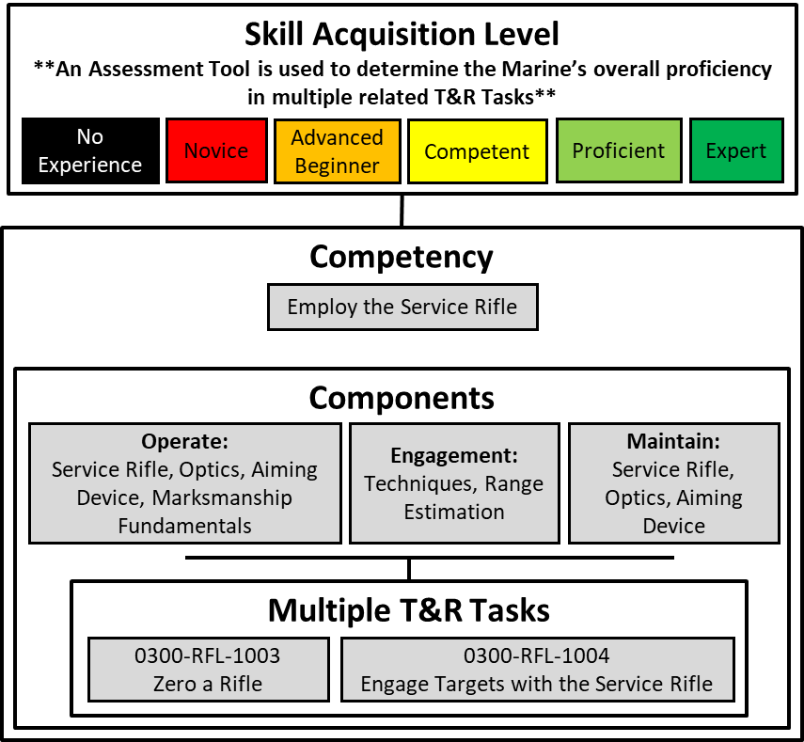
ITBn
Infantry Marine Course - Skillsets
Skillset | Historical ITB | IMC
Employ the Service Rifle | Adv. Beginner | Adv. Beginner
Optimize Human Performance | Novice | Novice
Embody the Marine Corps Philosophy of Warfighting | Novice | Novice
Operate in Aquatic Environment | N/A | Adv. Beginner
Conduct Fire and Maneuver | Novice | Adv. Beginner
Employ Demolitions | N/A | Adv. Beginner
Employ Mortars | Adv. Beginner | Being Developed
Employ Grenade Launchers | N/A | Adv. Beginner
Employ Machineguns | Adv. Beginner | Novice
Employ Anti-Armor | Adv. Beginner | Novice
Perform Tactical Combat Casualty Care | Novice | Adv. Beginner
Conduct Fieldcraft | Novice | Novice
Manage Signature | Novice | Adv. Beginner
Navigate to an Objective | Novice | Adv. Beginner
Patrolling | Novice | Adv. Beginner
Scouting | N/A | Novice
Defend a Position | Novice | Adv. Beginner
Combat Orders | Novice | Novice
Employ C4I | N/A | Adv. Beginner
Operate in Compartmentalized Terrain | Novice | Novice
 | 15* | 20

Slide 11
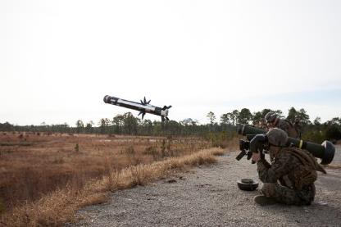
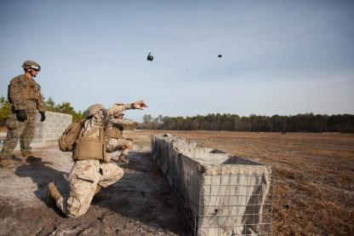
ITBn
Infantry Weapons Course
21 training days over 4 weeks
  Active Duty - Based on assignment, Marines are screened and selected to attend IWC to obtain 0331, 0341, or 0352 MOS
  All Contracted Weapons MOSs (predominately reservists) attend IWC
After IMC or IWC graduation, assigned to:
  Fleet Marine Force
  Marine Corps Security Force Regiment
  Marine Barracks at 8th & I
    Screening required
  Or follow-on MOS School (0313 or 0321).

Slide 12
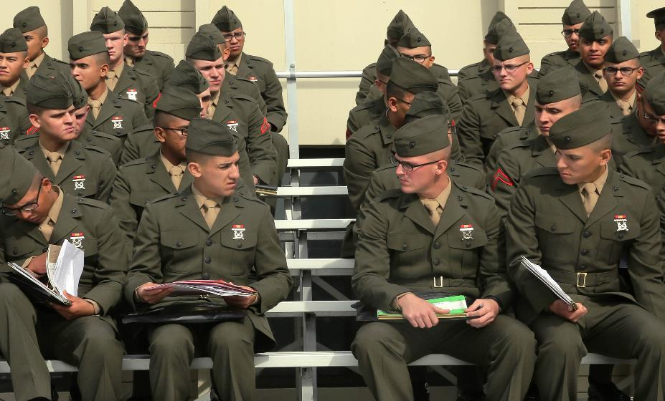
Reporting
Picture

Slide 13

Reporting
SOI-East is located at Camp Geiger, N.C. (aboard Marine Corps
Air Station New River (MCAS NR) in Jacksonville, NC.
Uniform for reporting is SERVICE ALPHAS
  Arrive on base in proper fitting Service Alphas.
  HAVE A FRESH HAIRCUT/ No designs or eyebrow slashing.
  Ensure you are in your Service Alphas and have 1 Set of Woodlands, Service book and Military ID on your Person/Carry on.
  Do not change in parking lots.
MCT Check-In
  You will be dropped at the Visitors center, where you will then get picked up VIA van and/or Bus
  You will then Check into Bldg. G540, Where the present Company will be located.
  Check in by 1200 on the day of your orders or you risk being dropped.
  MCT Officer of the Day (OOD): 910-376-5668
  Administrative Student Control (ASC): 910-449-2244
ITB Check-In
  Check into Bldg. G702 with ITB RSO&I Staff
  ITB Officer of the Day (OOD): 910-238-9833
  Administrative Student Control (ASC): 910-449-2244
  If not able to locate facility to conduct check-in please contact your respective OOD.
**Call your Recruiting Station as a default**

Slide 14
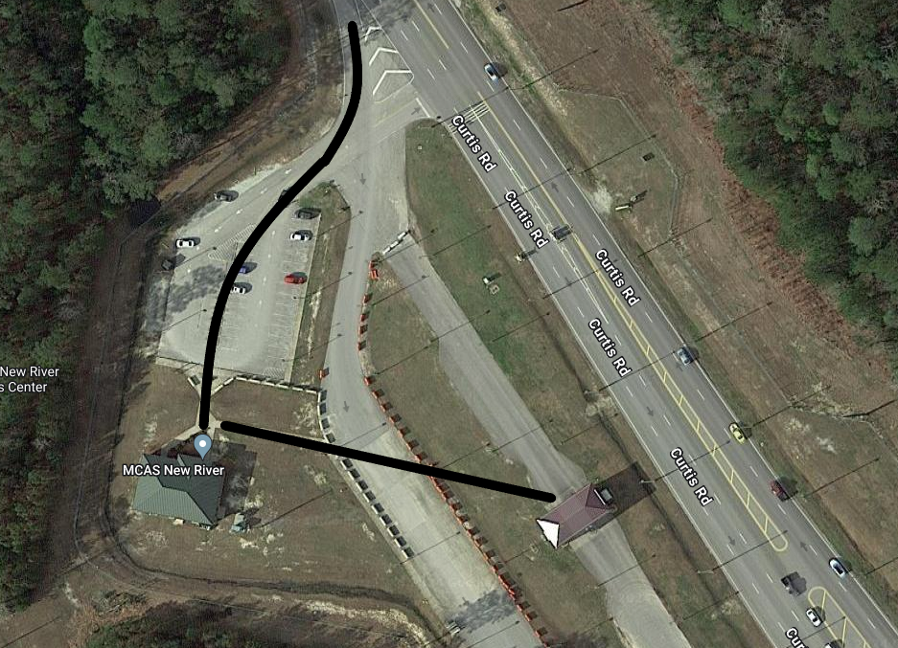
Map of Camp Geiger Visitors Center
CAMP GEIGER
Check in with Combat Instructor
Stage For Van And/Or Bus
CAMP GEIGER VISITORS CENTER
STUDENT PICKUP VIA VAN/BUS

Slide 15
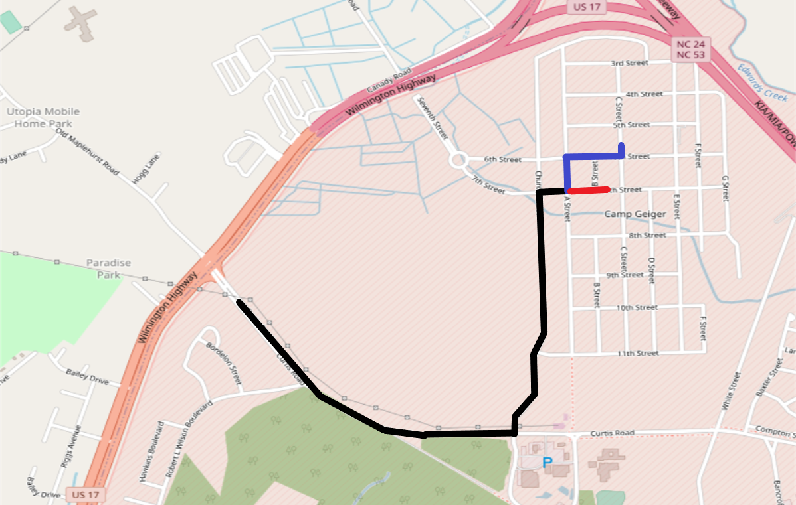

Map of Camp Geiger
CAMP GEIGER
MCT
CHECK IN
G540
ITB
CHECK IN
G702
CAMP GEIGER/ MCAS NEW RIVER FRONT GATE

Slide 16
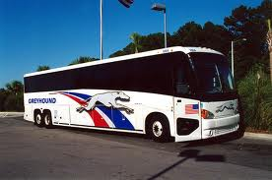
Reporting by Bus/Taxi
The bus station is four miles from Camp Geiger
Taxi fare is approximately $20 - $30
Travel in your SERVICE ALPHA UNIFORM or change before leaving bus station, pair up with other Marines reporting in to split taxi fare
  Save receipt, you may be reimbursed later.

Slide 17
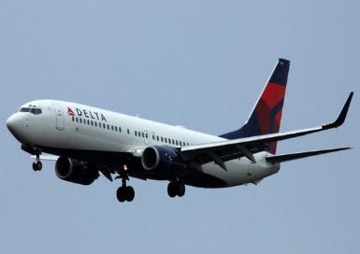
Reporting by Air
Albert J. Ellis Airport (Jacksonville, NC) is 16 miles from Camp Geiger
Taxi fare is approximately $35 – $40. You can team up with other Marines reporting in to split taxi fare.
Remember to change into your SERVICE ALPHA UNIFORM before arriving on base and checking into SOI-E.
  Save receipt, you may be reimbursed later.
Notes:
Detailed dates that the chartered buses run will be briefed by the 1stSgt since the buses DO NOT operate on a consistent time schedule. ( i.e. During the second or third week of the month on a Tuesday or Wednesday.)

Slide 18
Reporting
Check in no later than the date designated on
your orders. If you anticipate issues with arriving on time,
contact the appropriate OOD immediately.
MCT Marines are STRONGLY RECOMMENDED to check in between 0700-1200 on the date designated on your orders or you risk being dropped to the Marines Awaiting Training (MAT) Platoon (this will affect your follow-on MOS school).
Upon arriving in Jacksonville, NC, proceed to SOI-East IMMEDIATELY for check-in.
You ARE NOT authorized to obtain a hotel room and will receive billeting with your training battalion upon arrival.

Slide 19
Reporting Delays
If you miss your flight or bus, are involved in an accident, have any delays or cancellations dealing with your transportation or travel plans to SOI-East, it must be reported to MCT/ITB OOD immediately. If no contact is made with your training battalion refer to the ASC and the SOI-E OOD.
** Call the ASC during working hours. Call the OOD after working hours, during weekends and holidays.**
ASC: 910-449-2244 (Normal working hours 0730-1630)
SOI-E OOD Office: 910-449-0179
SOI-E OOD Cell: 910-376-5485
Additional info may be obtained at: https://www.trngcmd.marines.mil/Units/School-of-Infantry-East/

Slide 20
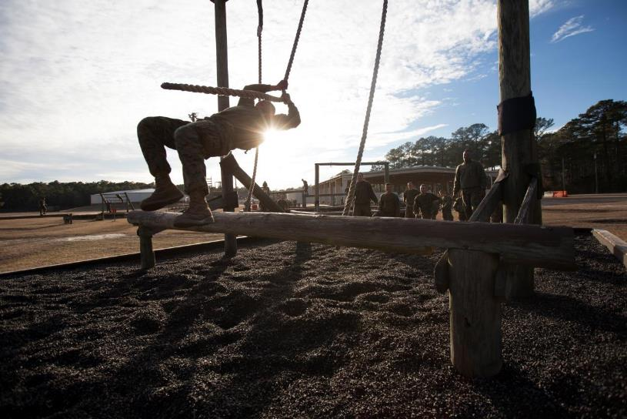
Important Info

Slide 21
Important Info - PRASP
• Check-in with your recruiter immediately upon getting home on leave.
• Inform them of your PRASP, get specific instructions and follow the prescribed checklist from your local recruiting station.
Report in your SERVICE ALPHA UNIFORM
DO NOT give the recruiter your original orders; you will need them when you check into SOI-East.
Must arrive at SOI-East with a separate reporting and attaching endorsement.
Last minute PRASP requests while on Boot Leave will not be entertained; you must leave MCRD with PRASP orders.
PRASP will not be approved between MCT and follow-on MOS school.

Slide 22
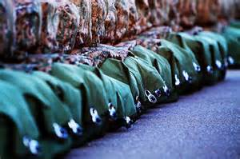
Important Info – Things to Bring
Military-issued prescription glasses only (must have)
  Do not throw away frames, lens can easily be replaced.
  NO CONTACTS!! They will not be permitted at any time during training.
Carry-on bag/ On your person:
  Service Alphas (full uniform)
  (1) Set of woodland utilities
  w/ cover and boots/bands
  Service Record Book
  Medical/Dental records
  Hygiene gear
  Ballistic Inserts

Slide 23
Important Info – Things to Bring
Bring everything you were issued at boot camp!
  All Uniforms – do not give any uniform items away, you will pay for replacements
(1) set of appropriate civilian attire (minimum)
Cell Phone – you will need it to access Moodle and training resources/study materials.
Cash/Debit Card ($200.00)

Slide 24


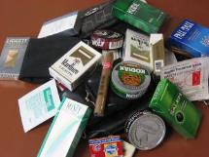
Important Info – Do Not Bring
Electronic devices (Kindles, gaming systems, laptops)
Your privately owned vehicle (POV)
Knives, Gerbers or any other personal weapons
Your spouse or children
Any tobacco products
Vapes (they will be destroyed)
Any alcohol
Any supplements

Slide 25
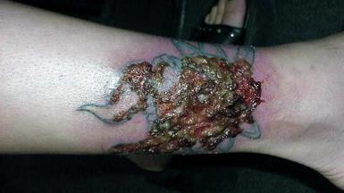

Important Info – Do Not!
Do not close your old bank account
Do not spend all your money while on leave
Do not hang-out in Jacksonville prior to reporting in
Do not lose your original orders
Do not get married while on leave or PRASP
Do not get tattoos while on leave or PRASP

Slide 26
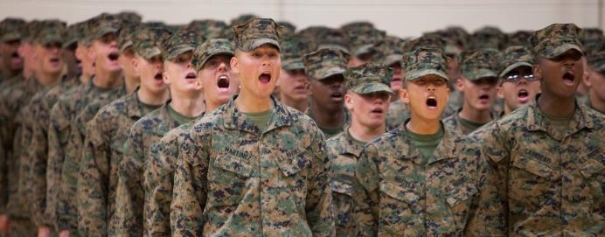
Important Info – Liberty
Liberty
  MCT: On-base liberty Sunday prior to graduation
  ITB: On-base liberty during most weekends
Remember, liberty is a privilege, not a right.

Slide 27
Expectations on Leave
Expired prescription drugs
  DO NOT take your parent’s or friend’s medication
Positive urinalysis will result in processing for ADMIN SEPARATION, with an Other Than Honorable Discharge.
You will be tested upon check-in!
DO NOT drink and drive OR drink alcohol if you are
Underage.
Physically check-in with your recruiter and/or station.
Maintain height and weight standards, continue to PT while on leave or PRASP.
Maintain professionalism and grooming standards of a
United States Marine.
Uphold our Core Values of Honor, Courage, and Commitment.
Enjoy your leave and remember you are now subject to the UCMJ

Slide 28
Contact Information
Administrative Student Control /Officer of the Day contact numbers:
  ASC: 910-449-2244
  MCT OOD: 910-376-5668
  ITB OOD: 910-238-9833
  SOI-E OOD Office: 910-449-0179
  SOI-E OOD Cell: 910-376-5485
  Media:
  https://www.trngcmd.marines.mil/Units/School-of-Infantry-East/
  Mailing Address:
  Rank, Last Name, First Name, MI
  School of Infantry – East (Company)
  PSC Box 20161
  Camp Lejeune, NC 28542-0161

Slide 29
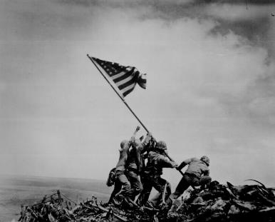
Sustain the Transformation!
You are a Marine 24/7
Your actions reflect the Marine
Corps on and off duty
Keep your honor clean and continue to earn the title!

Slide 30
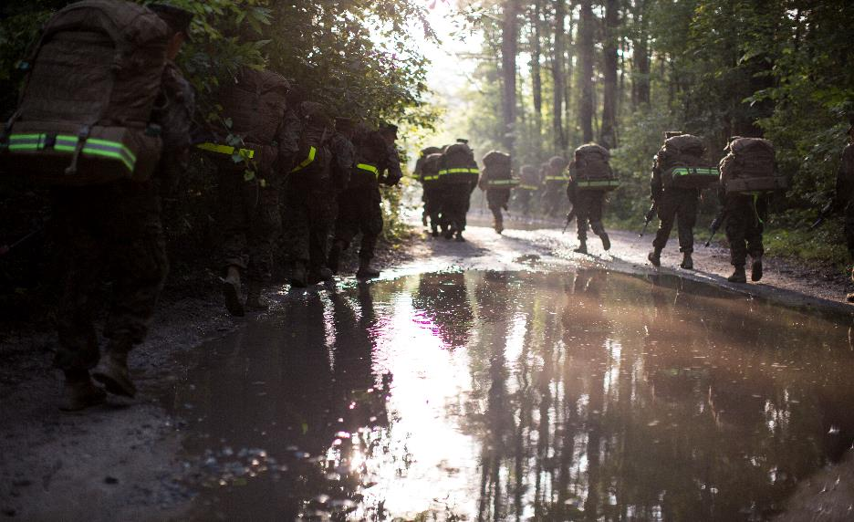
Questions?

